Slide 1


Data Analysis Techniques 890F3
Describing Data

Slide 2
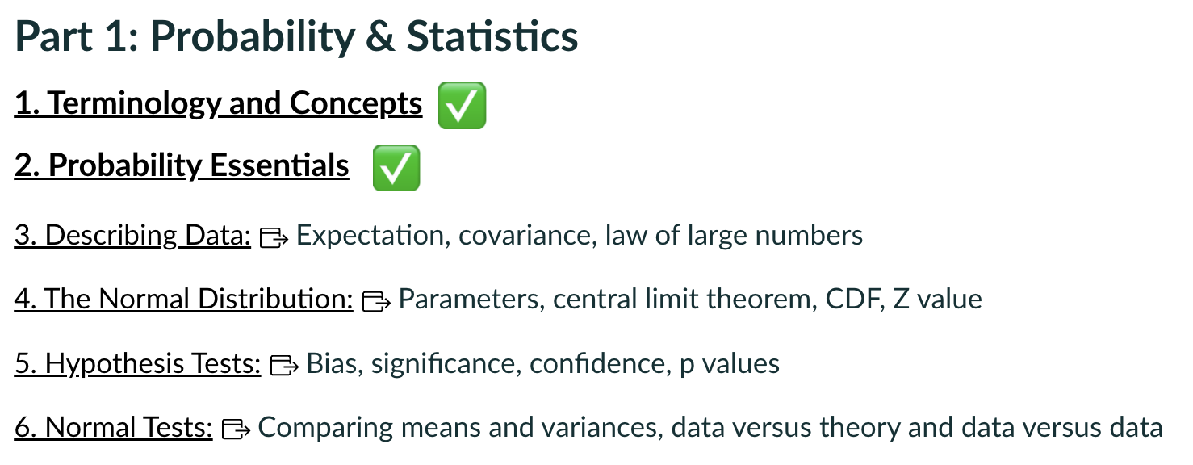
Where we are
Broad & Shallow intro to things we will keep revisiting
Today
Find your own pace.
This lecture has extension material (a bit trickier) not yet in the notebook.

Slide 3

Your learning
Lectures
Workshops
Independent Study
Lectures will generally focus on a couple of select topics from the notes, and extension/additional related materials.
Please read through the relevant notes before the lecture, especially if this is your first rodeo.

Slide 4
Your learning
Lectures
Workshops
Independent Study
Workshops will consist of python exercises.
The point is to encourage student-led investigations into solving relevant problems using python.
The example solutions I provide after the workshop are not model solutions. They are narrative suggestions for DT <-> student discussions.

Slide 5
Your learning
Lectures
Workshops
Independent Study
Independent Study is for you to decide, and will be strongly dependent on your background.
I know this can feel like an abyss, especially for students with multiple competing commitments.
Baseline: Jupyter book, coursework, workshop exercises
Extra: See the resources at the bottom of the jupyter book front page, and find your own.
Think: How are the topics relevant to your project/dissertation/future job interview?

Slide 6
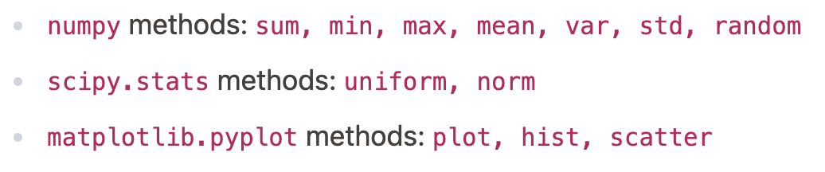
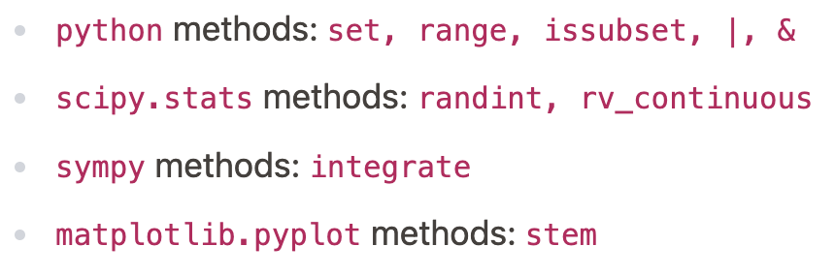
Tools introduced in sections 1 & 2
Find your own pace.
New to python: you will get lots of practice this term.
Experienced and expert: focus on an area you are not expert in.

Slide 7
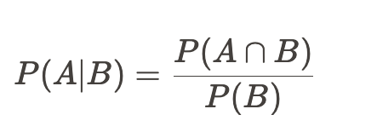
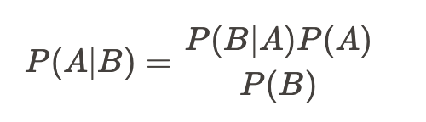
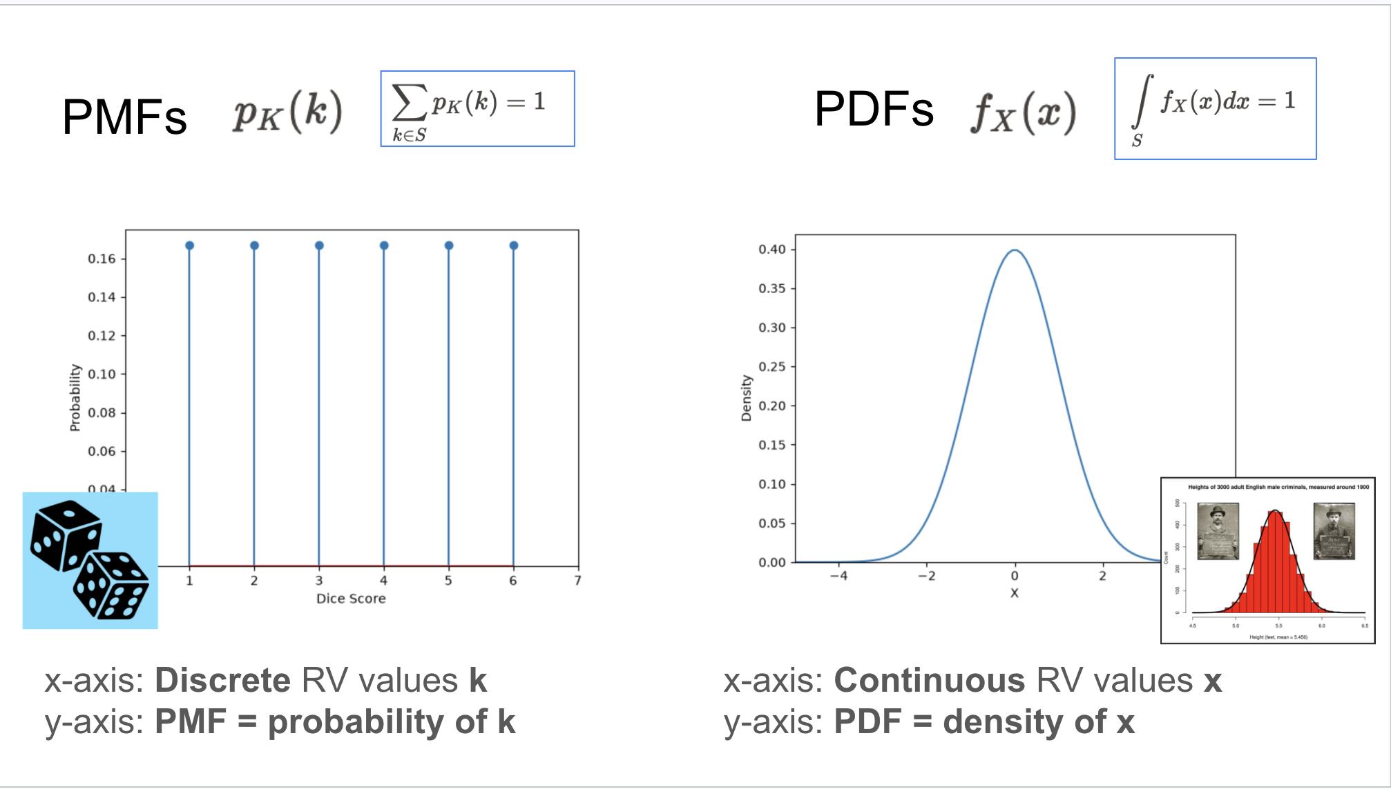
Recap Probability Essentials
Conditional = Joint / Total
We focused on:
Conditional and Total Probability
Bayes’ Theorem
Distributions, Normalisation
Bayes’ Theorem only has Conditionals and Totals

Slide 8
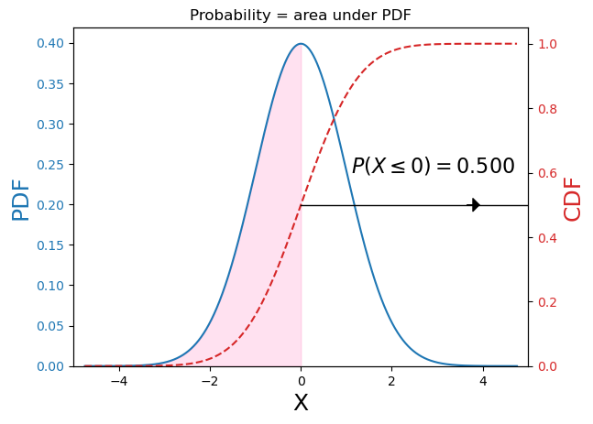
Recap Probability Essentials
We will revisit the CDF lots of times
We noted that the PDF does not return a probability, but a density.

Slide 9
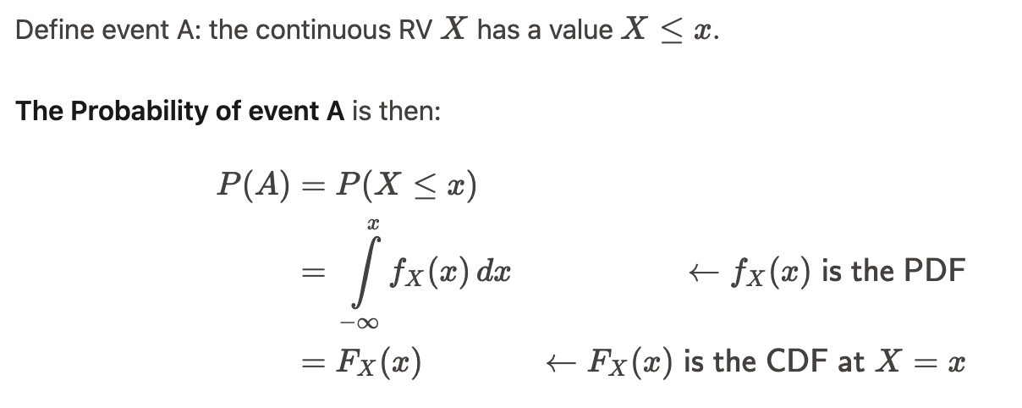

Slide 10
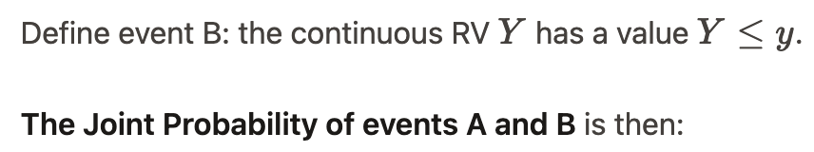
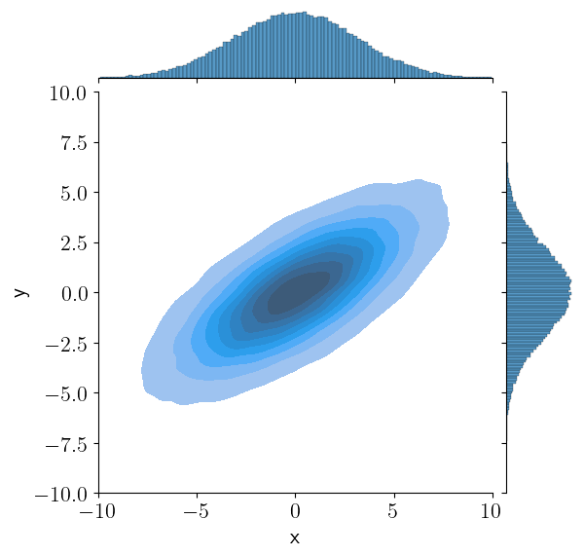
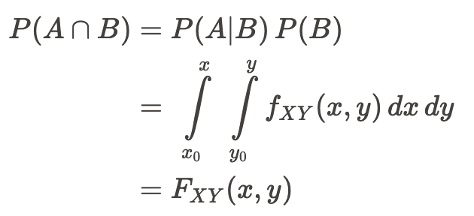
Joint PDF

Slide 11
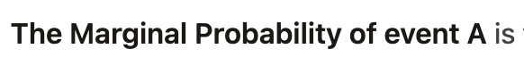
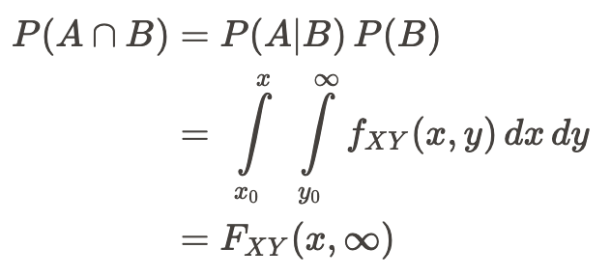
Marginal PDF for X
Marginal PDF for Y

Slide 12
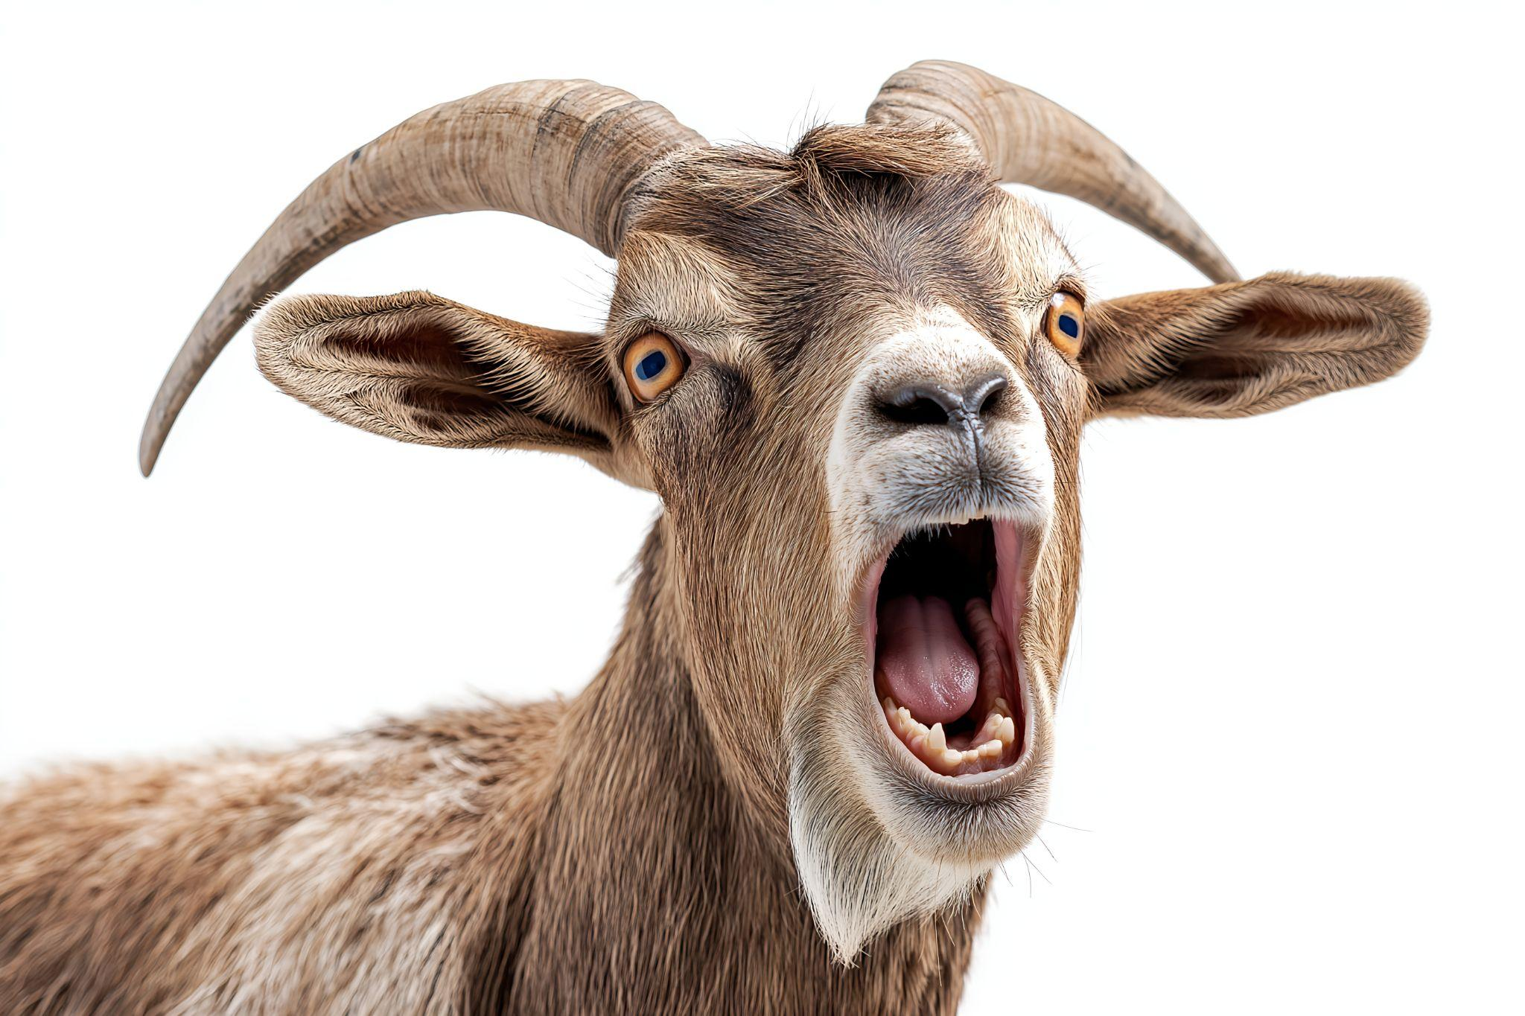
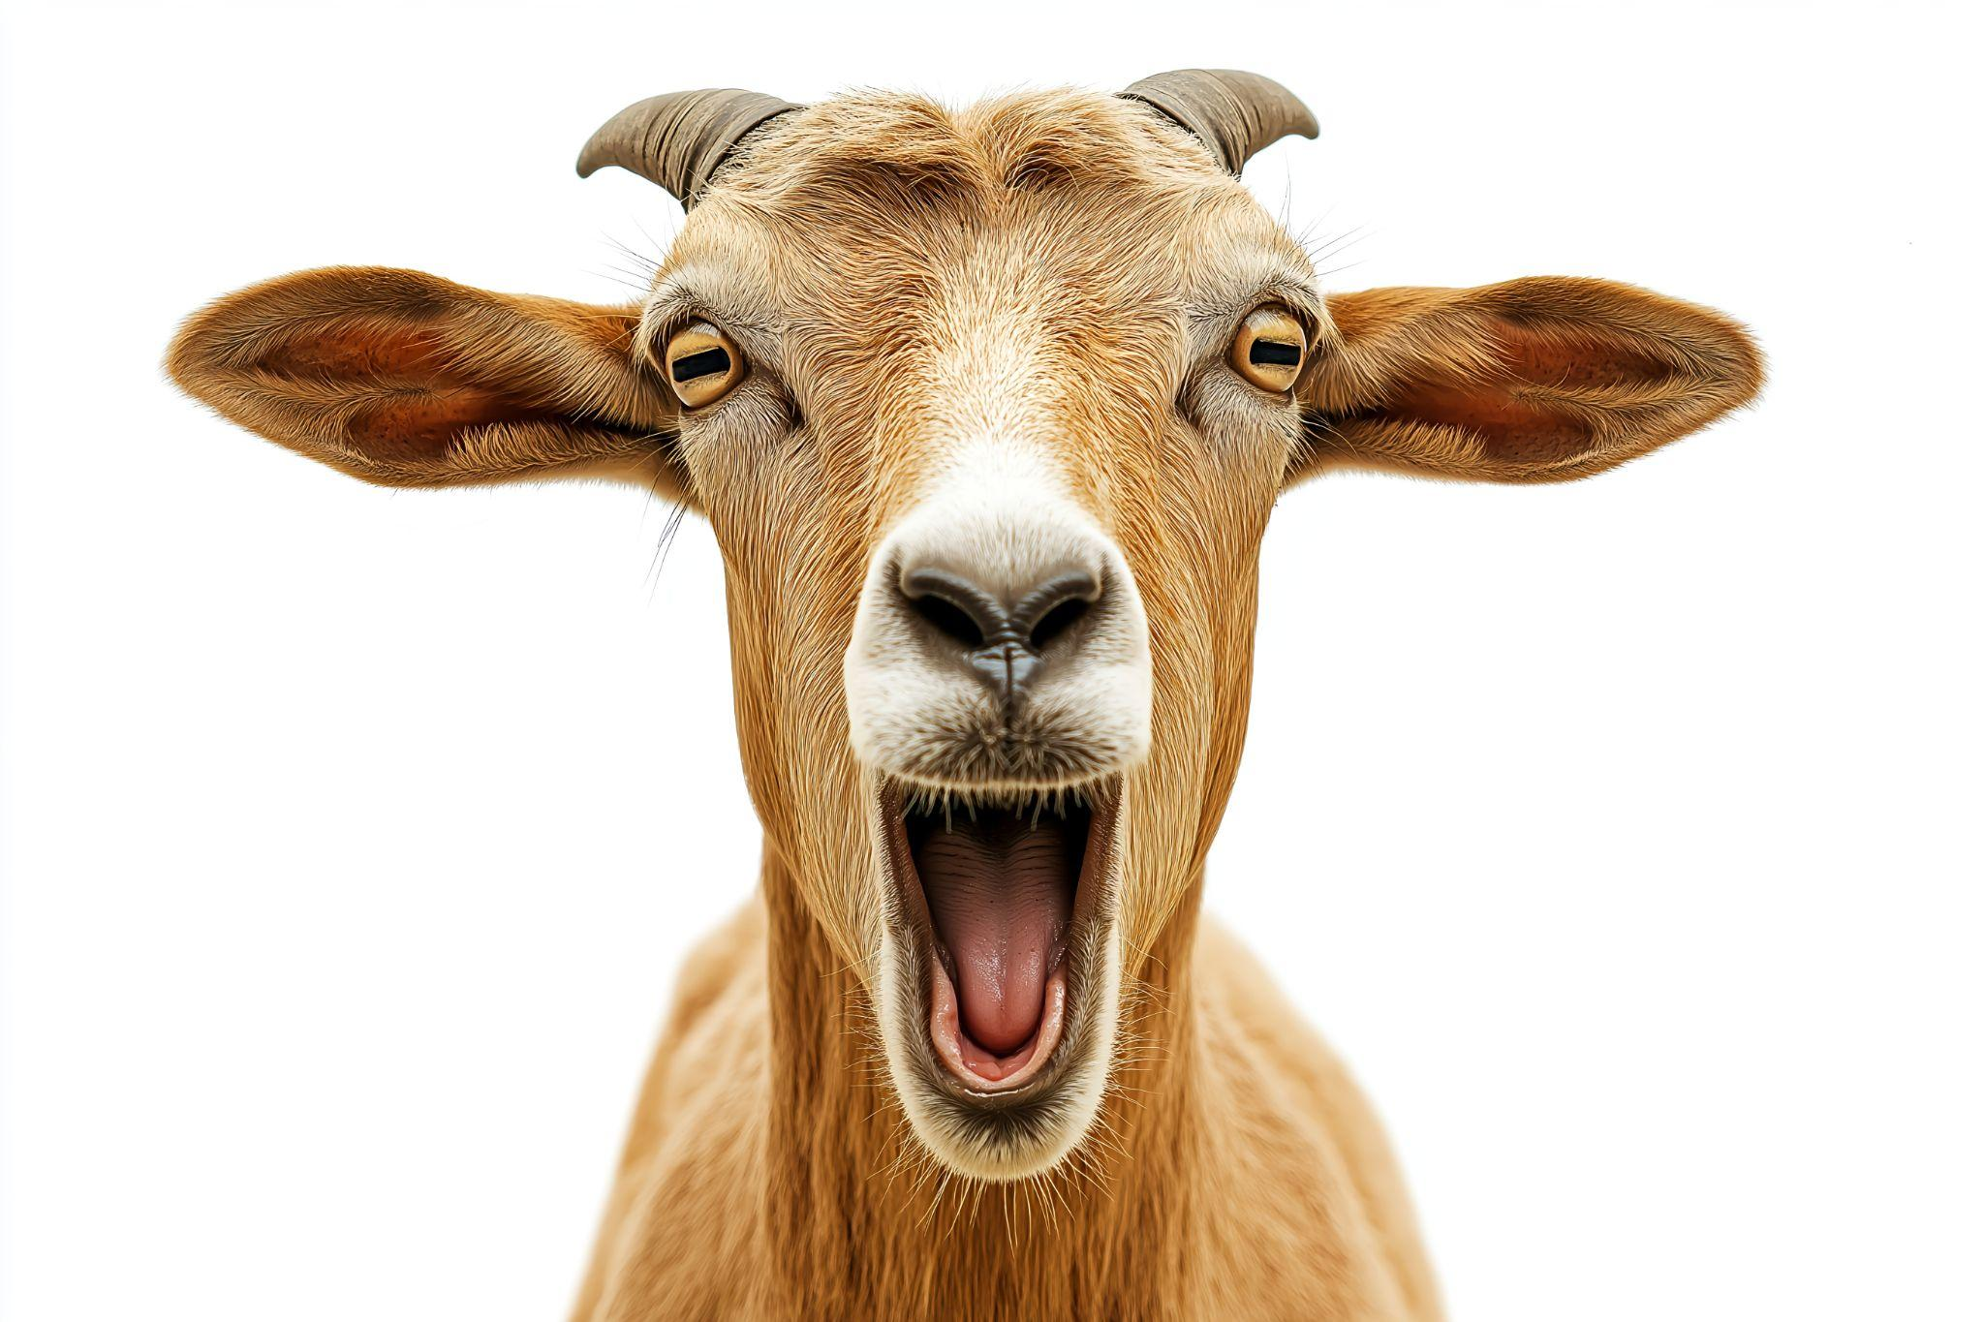

Monty Hall
Discovering a potential employee who could explain this clearly would impress me

Slide 13
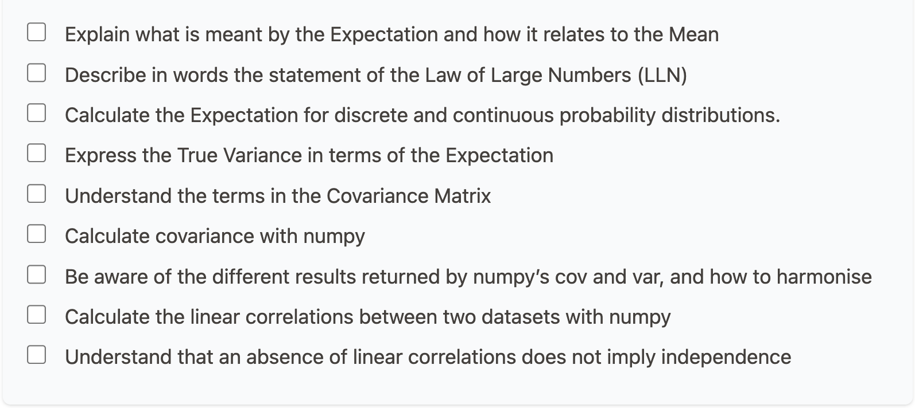
Describing Data

Slide 14
Focus
Find your own pace.
The True mean E[X] and variance V[X]
Covariance and Linear Correlations
* Uncertainties on functions using Expectation Algebra and using Taylor Series *
* The last part might be challenging for those with less privileged math backgrounds, but some of the students here will appreciate a reminder/intro to the methods for propagating uncertainties.

Slide 15
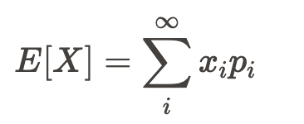
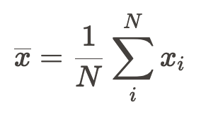
Expectation: needs a probability distribution
Discrete probabilities sum to 1.
Expectation is normalised without needing the 1/N
When calculating the mean of a dataset, we do not rely on knowing the underlying probability distribution

Slide 16
Expectation: True Mean
Infinite number of measurements - not available to us in the real universe!
The Expectation (truth) has a single fixed value.
The mean can change every time we add a new measurement.

Slide 17
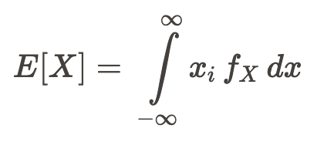
Expectation for discrete and continuous RVs
Discrete RV
p_{i} is PMF: probability of measuring value x_{i}
Continuous RV
f_{X} (x_{i}) is PDF: not a probability

Slide 18

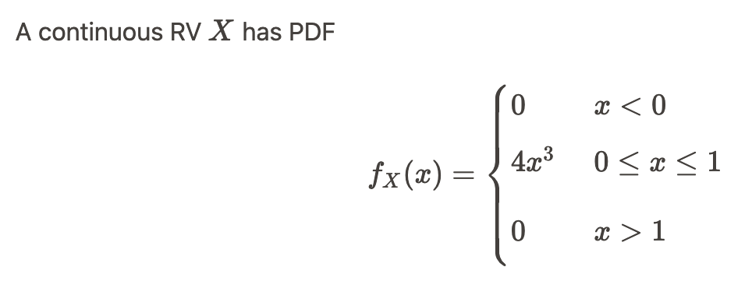
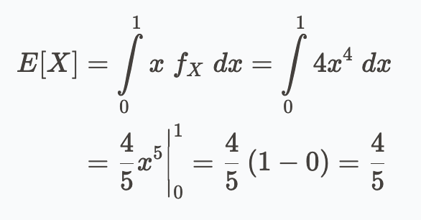
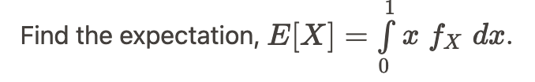
Expectation Example
The expectation is the mean value of the PDF over its support.

Slide 19
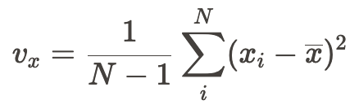
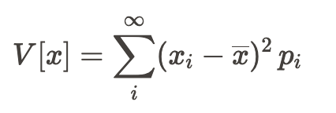


Expectation and Variance
 | Mean | Variance
Measured
True
We can define the true variance in terms of the expectation:
or
Both these forms are useful. See notes for proof.

Slide 20
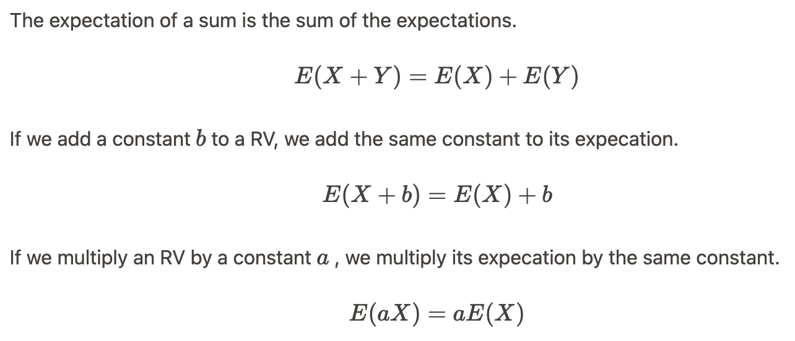
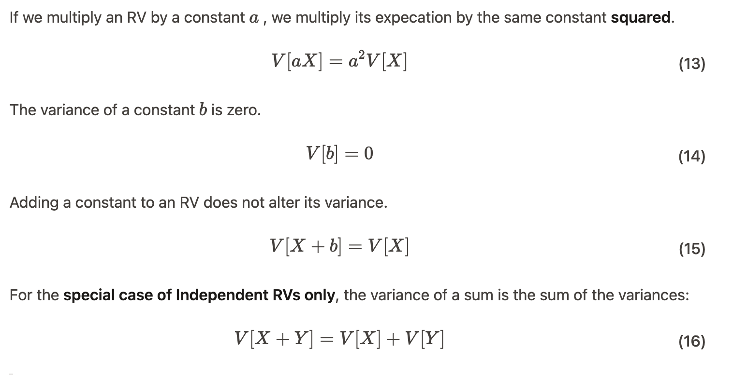

Expectation and Variance Algebras
a,b are constants (numbers)
Mean
Variance
Only if the RVs are independent

Slide 21
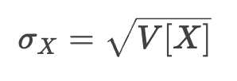
Why do I keep going on about expectation and variance?
Measurements are meaningless without uncertainties!
E[X] gives us V[X], and V[X] : variability in the true distribution.

Slide 22
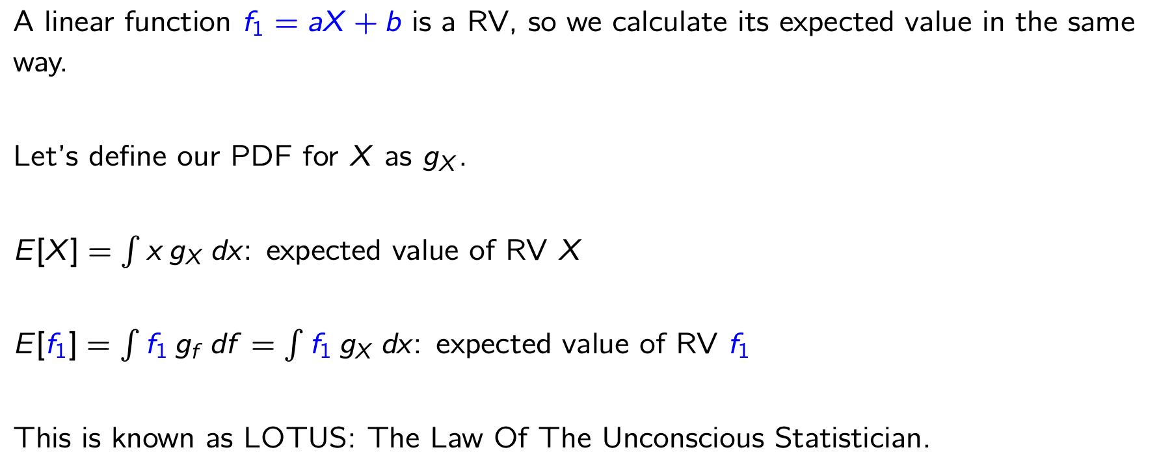
What if the uncertainty I seek is on a function of the RV?
If I know the statistical uncertainty on my measured X (the standard deviation), how do I calculate the uncertainty on my result, which is some f(x) ?
E[f] gives us V[f], and V[f] gives us 𝜎_{f}

Slide 23
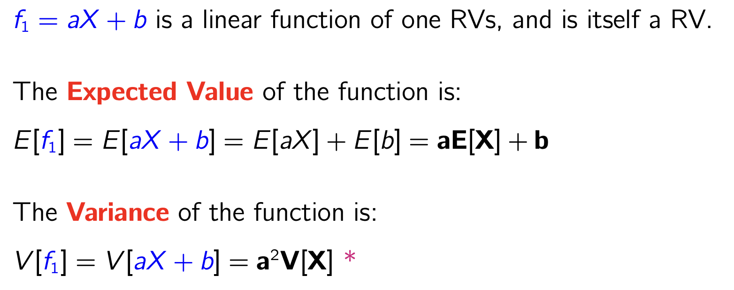
Example: linear function of one RV
Notice this gives us an uncertainty of σ_{f} = aσ_{x} this may be familiar to some?

Slide 24
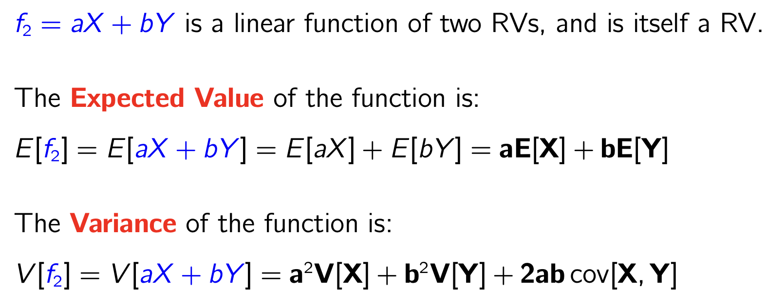
Example: linear function of two RVs
For independent X,Y the Variance of the function is
Only if the RVs are independent
because
Notice this gives us an uncertainty of σ_{f} = √( ) - this may be familiar to some? Is called “summing in quadrature”

Slide 25
Example: linear function of two RVs
If the RVs are not independent, or if we cannot assume they are, we get an additional term: the covariance term.

Slide 26
Part 2! (3pm)
CY DE OH

Slide 27
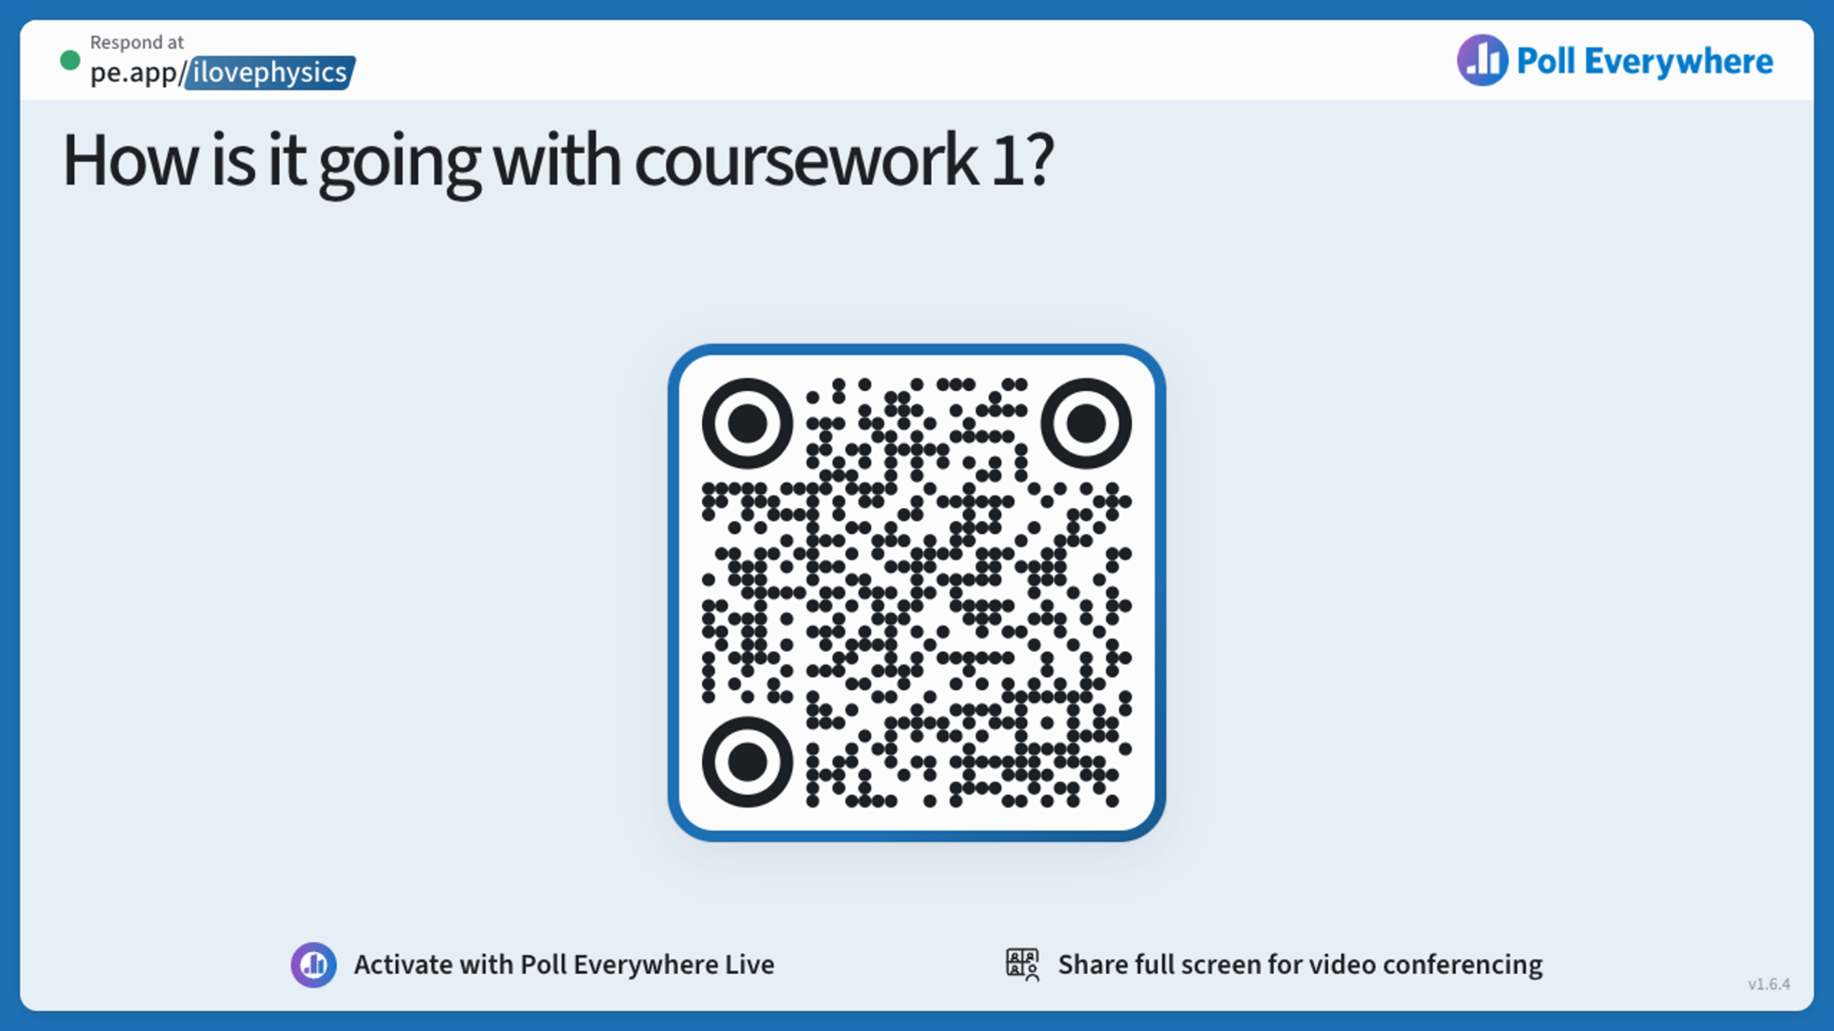

Slide 28
Lily’s Office Hour
Pevensey 2 Foyer
Tuesday
12-1pm

Slide 29
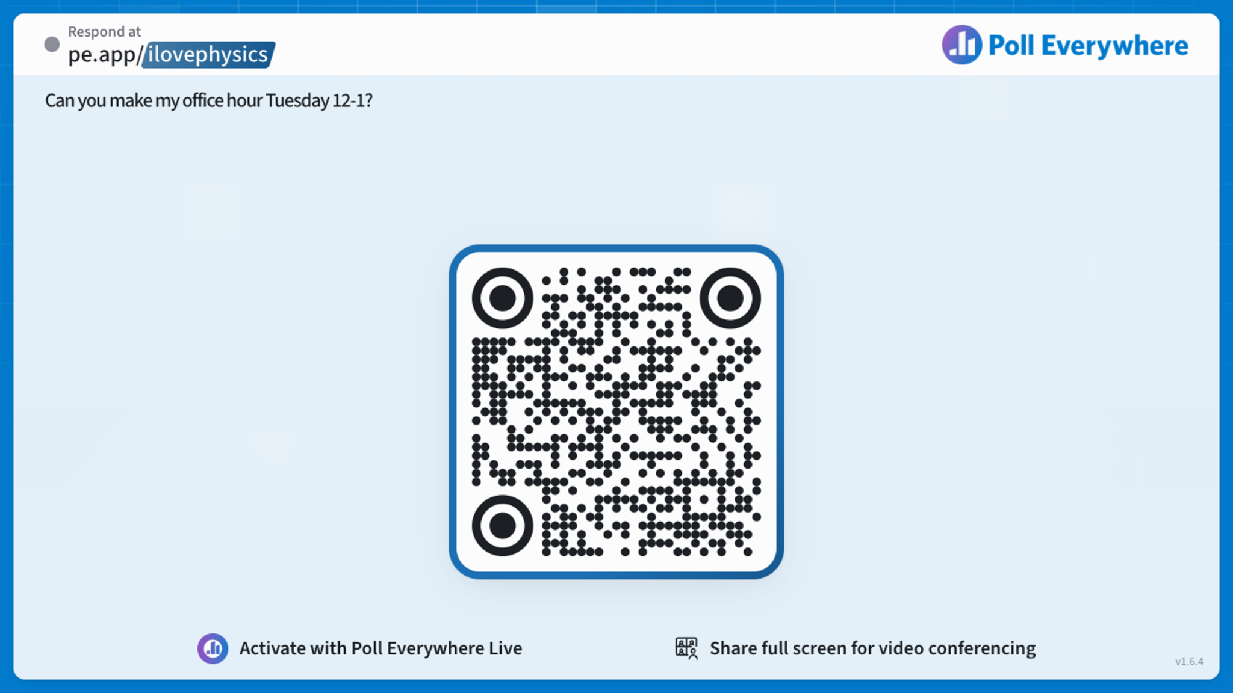

Slide 30
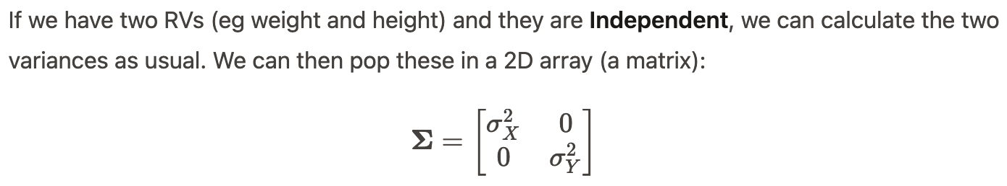
Covariance
Note: height and weight measurements of the same people would not be independent.
Variance of X = square of standard deviation = square of statistical uncertainty
Variance of Y = square of standard deviation = square of statistical uncertainty

Slide 31
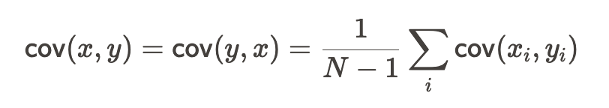
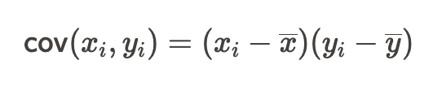
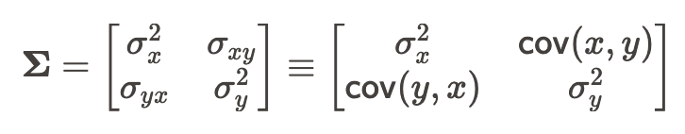
Covariance
Compare with variance
If the RVs are Dependent, we additional have Covariance terms.
The Covariance Matrix (“Error Matrix”) for 2 RVs:
The Covariance Matrix is square (Nrows=Ncolumns=N RVs) and symmetric (diagonal elements are equal, cov(x,y) = cov(y,x)

Slide 32
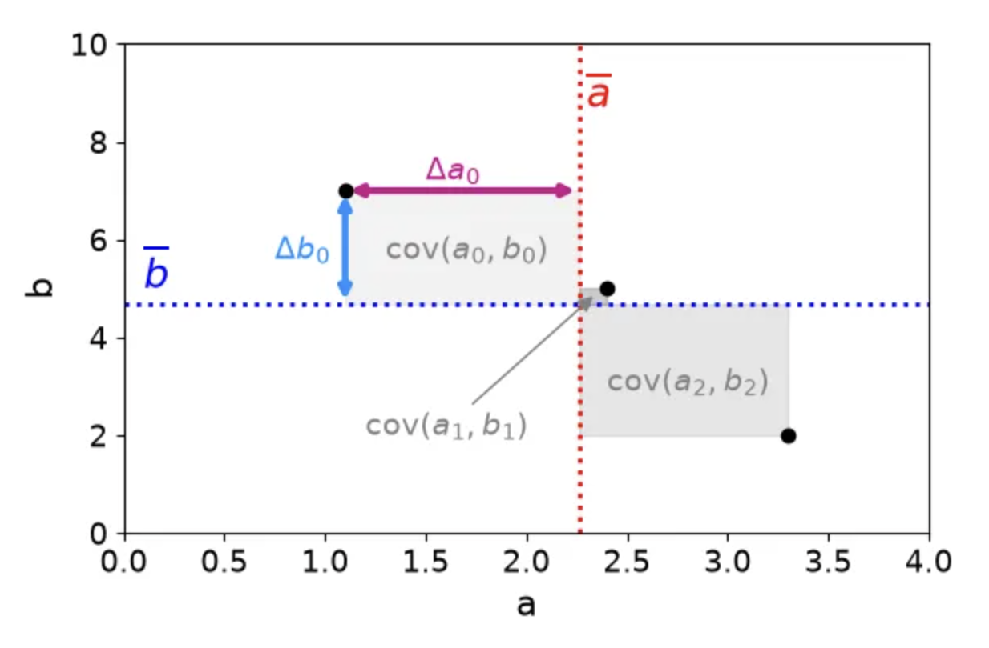
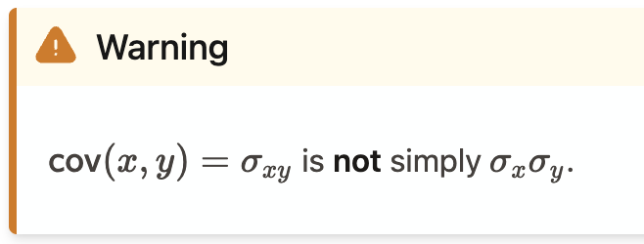
Covariance Matrix
We can draw the individual covariances as areas on a scatter plot.
Note that we cannot do this for individual variances.

Slide 33

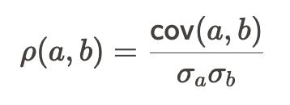
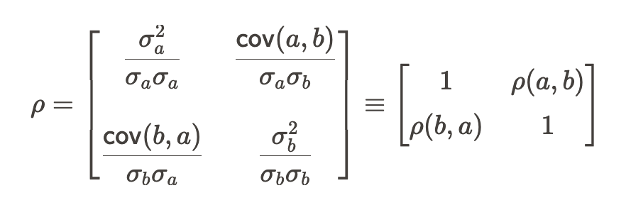
Linear Correlations
The values of cov(a,b) will grow larger and larger the more data we take.
Normalise them (-1,1) using the product of standard deviations to get the linear correlation coefficient
The linear correlation matrix is:

Slide 34
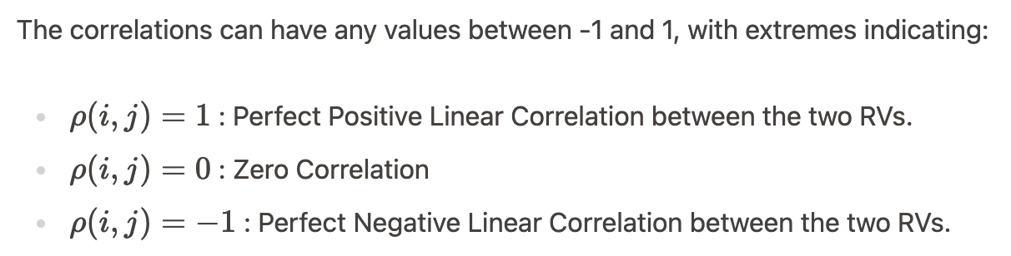
Linear Correlations
Linearly Independent RVs should* have ~0 correlation coefficient.
BUT
Dependent RVs can alo have ~0 correlation coefficients!
*You may encounter an example of spurious linear correlations in this week’s workshop :)

Slide 35
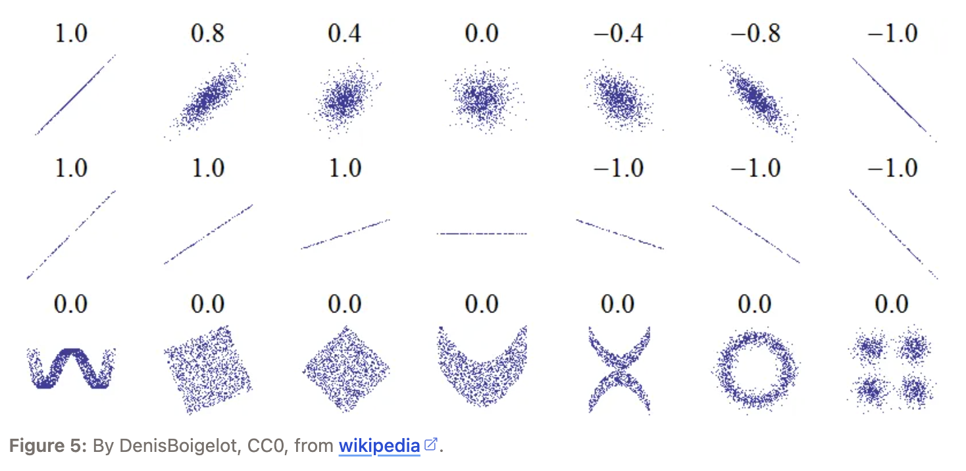
Dependent RVs can have zero linear correlation…
…if the relationship between the RVs is nonlinear
Always plot your data!

Slide 36

Find your own pace: the next ten slides are not for beginners
In workshops, in lectures, in the library, in your favourite spot on the computer at home with a nice cup of tea.
Find something you can take from the time. It might be that you learned a new notation or word, or maybe you had an “aha” moment about some little thing.
Whatever it is, make a note of it. It’s progress.
If you don’t have a math background, you could spend this time well enjoying:
https://www.tylervigen.com/spurious-correlations
You can’t “learn” data analysis techniques in lectures. You can only learn by doing.

Slide 37
Back to Uncertainties!
If the RVs are not independent, or if we cannot assume they are, we get an additional term: the covariance term.

Slide 38
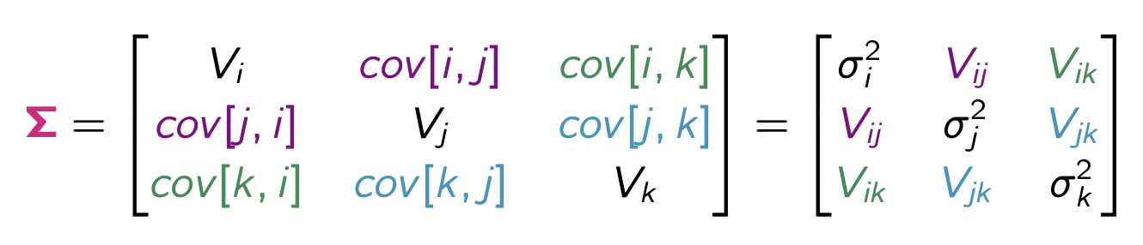
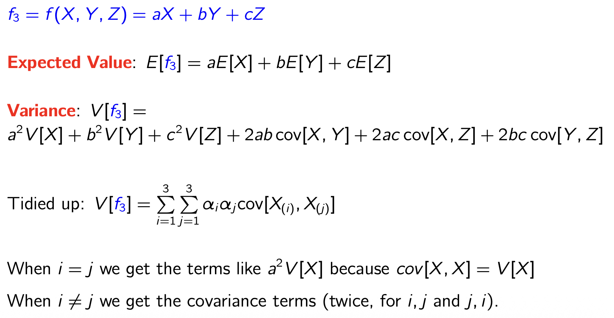
Three RVs:
Covariance matrix for three RVs: X_{(i)},X_{(j),} X_{(k)}:
This is a bit long. But there is a pattern we can exploit…

Slide 39
Three RVs: tidy notation
Here i is the row index, j is the column index

Slide 40
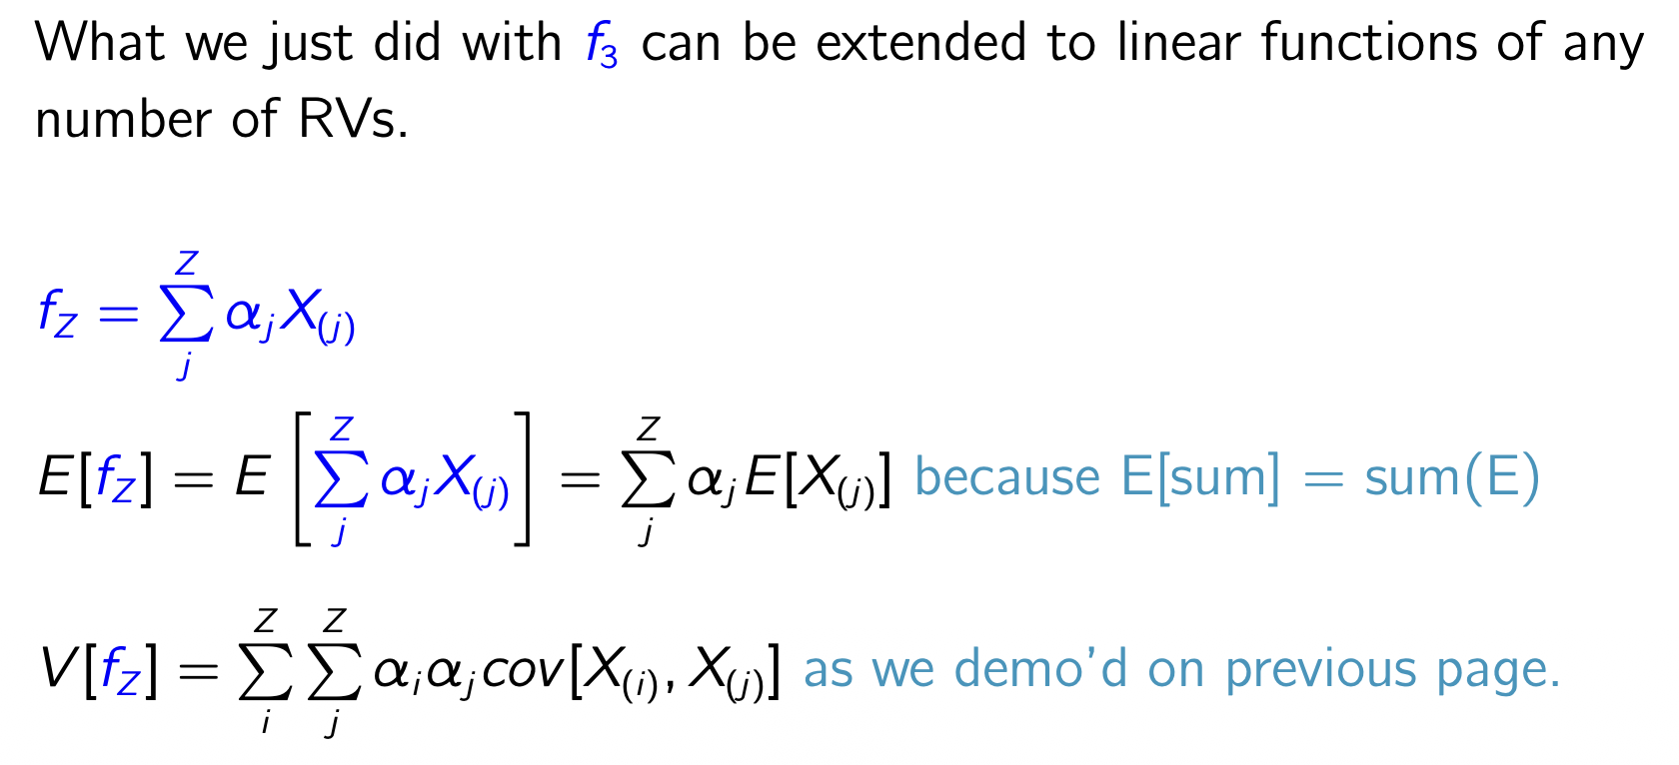
Any number, Z, of RVs

Slide 41
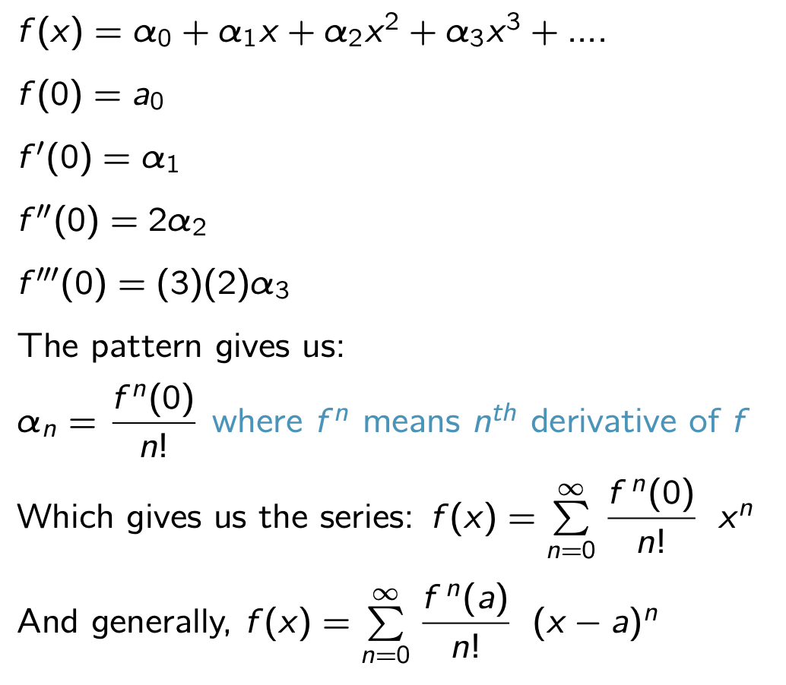
Using the Taylor Series expansion
α are the coefficients
Value of f(x) when x=0
Value of first derivative of f(x) when x=0
Second derivative, etcetera
Known as the Maclaurin series

Slide 42
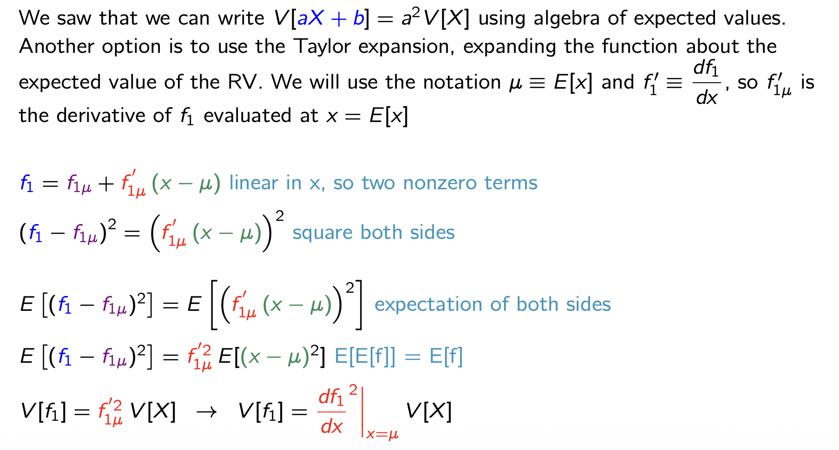
One RV - using Taylor Series
(truncated Taylor series)
Variance of linear function of 1 RV = (first derivative squared) x (variance of RV)

Slide 43
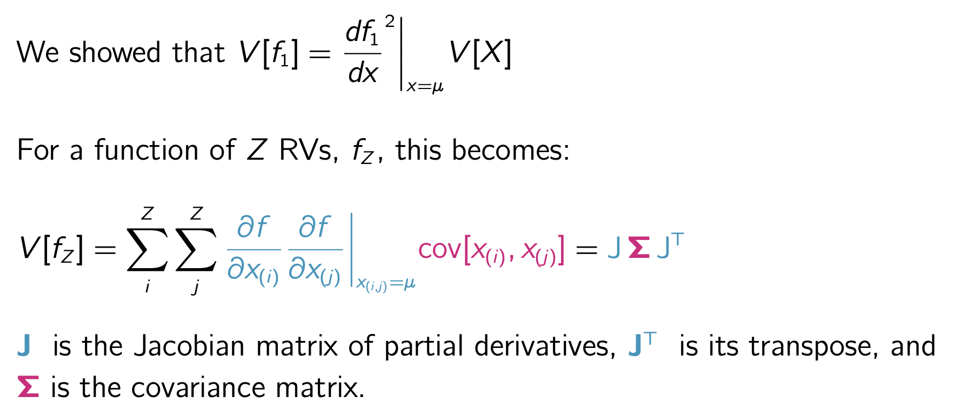
Z RVs - using Taylor Series
A Jacobian Matrix holds the partial derivatives of a function with respect to each of the RVs
Transpose: switch columns with rows

Slide 44
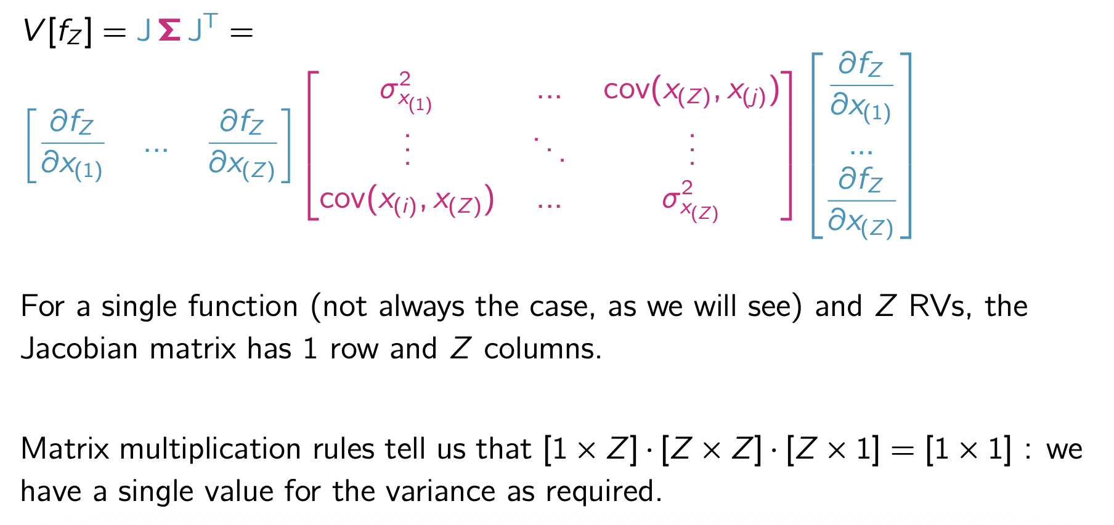
Z RVs - using Taylor Series
This is nowhere near as horrific as it appears to be - see the workshop 3 optional math exercise

Slide 45
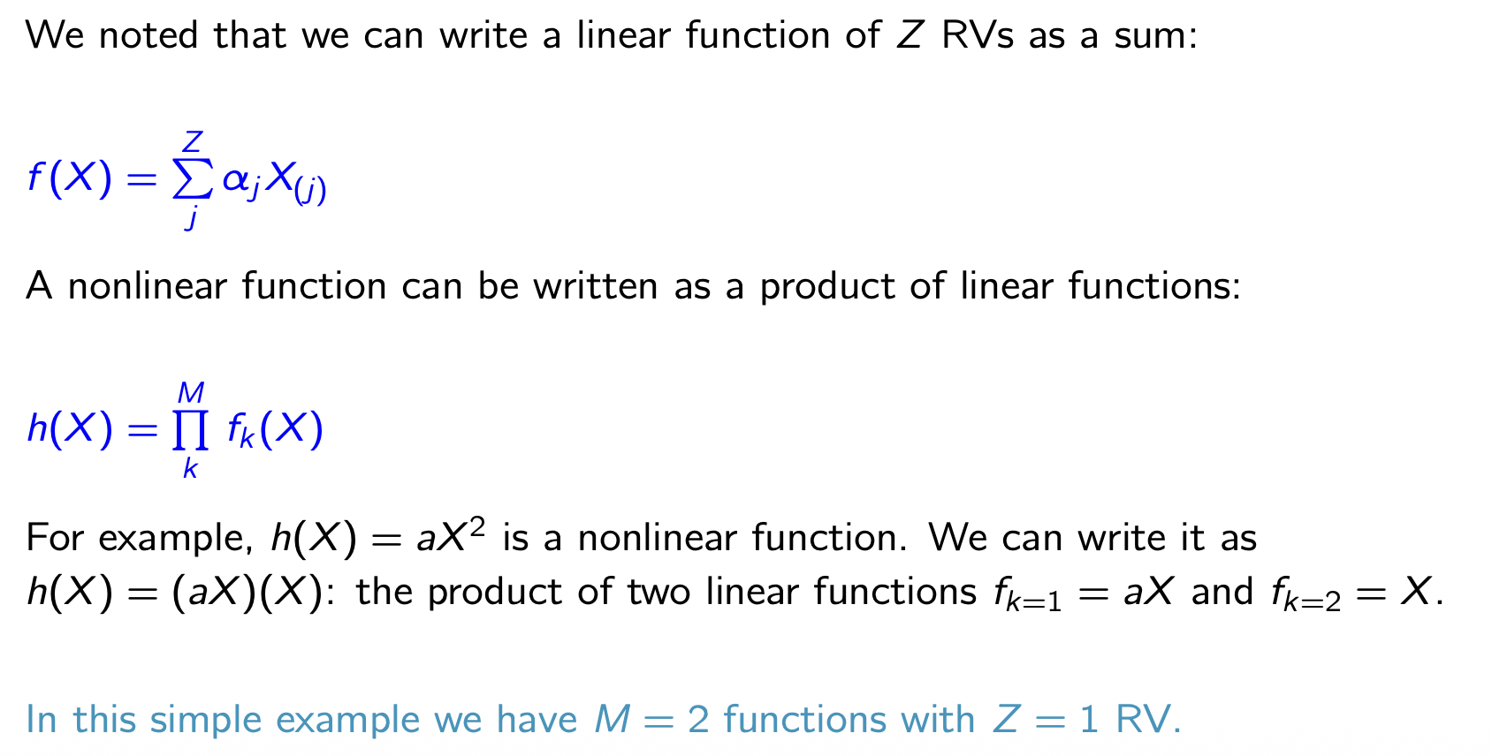
What about Nonlinear Functions?

Slide 46

The Jacobian for a Product of M Functions
Jacobian = Jacobian Matrix.
Sometimes people say “Jacobian” to mean “the determinant of the Jacobian Matrix”. We will come back to this.

Slide 47

Variances for a Nonlinear Function

Slide 48

Summary in Plain English

Slide 49

What about Systematic Uncertainties?
Systematic Uncertainties are uncertainties associated with our limited confidence in the measurement itself, rather than the underlying distribution. For example, my height is 171 cm +/- 1cm.

Slide 50
Thanks for your time
Fin

